Slide 1
Utilizing Student Workers for Digital Commons Projects
Ellen Amatangelo
Elizabeth Parret
Brigham Young University Library

Slide 2
Student Projects
Journal and Event Uploading
Faculty CVs
Clean Up Projects

Slide 3
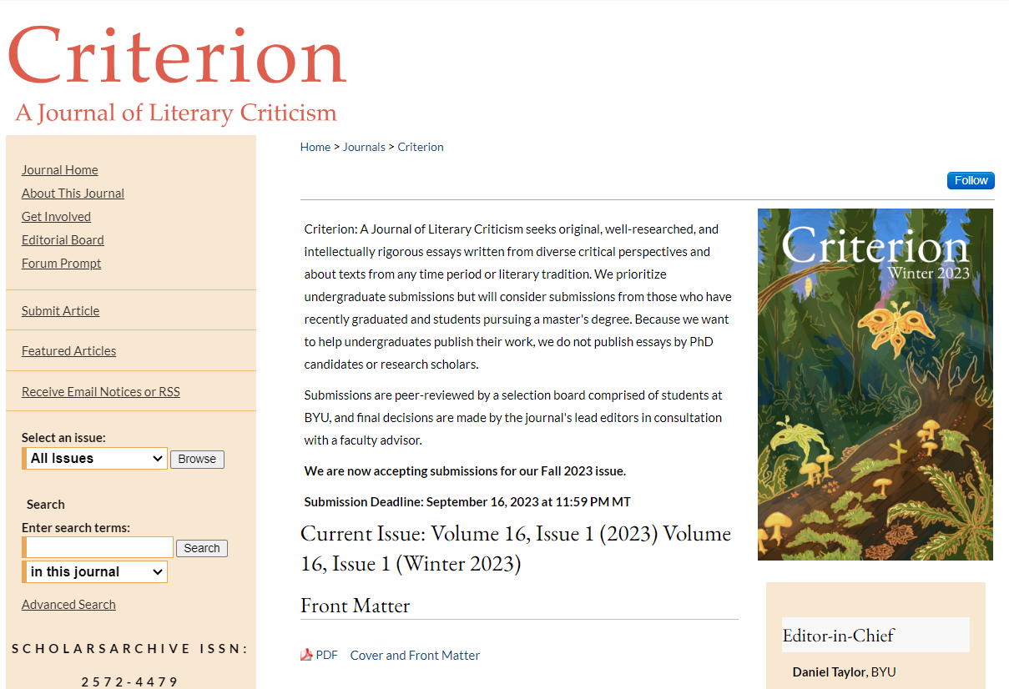
What Students Do
Journal and Event Uploading
Faculty CVs
Clean Up Projects
Edit full issue PDFs in Adobe Acrobat Pro
Create new volumes and issues, tracks, etc.
Upload individual submissions
Publish to the site
Research publication list to find articles freely available online
Upload articles to site
Compile list of works to be requested from the author
Research publisher permissions
Work on spreadsheets
Add missing metadata
Standardize existing metadata
Create and add missing handle links

Slide 4
Elizabeth
At Contoso, we believe in giving 110%. By using our next-generation data architecture, we help organizations virtually manage agile workflows. We thrive because of our market knowledge and great team behind our product. As our CEO says, "Efficiencies will come from proactively transforming how we do business."

Slide 5
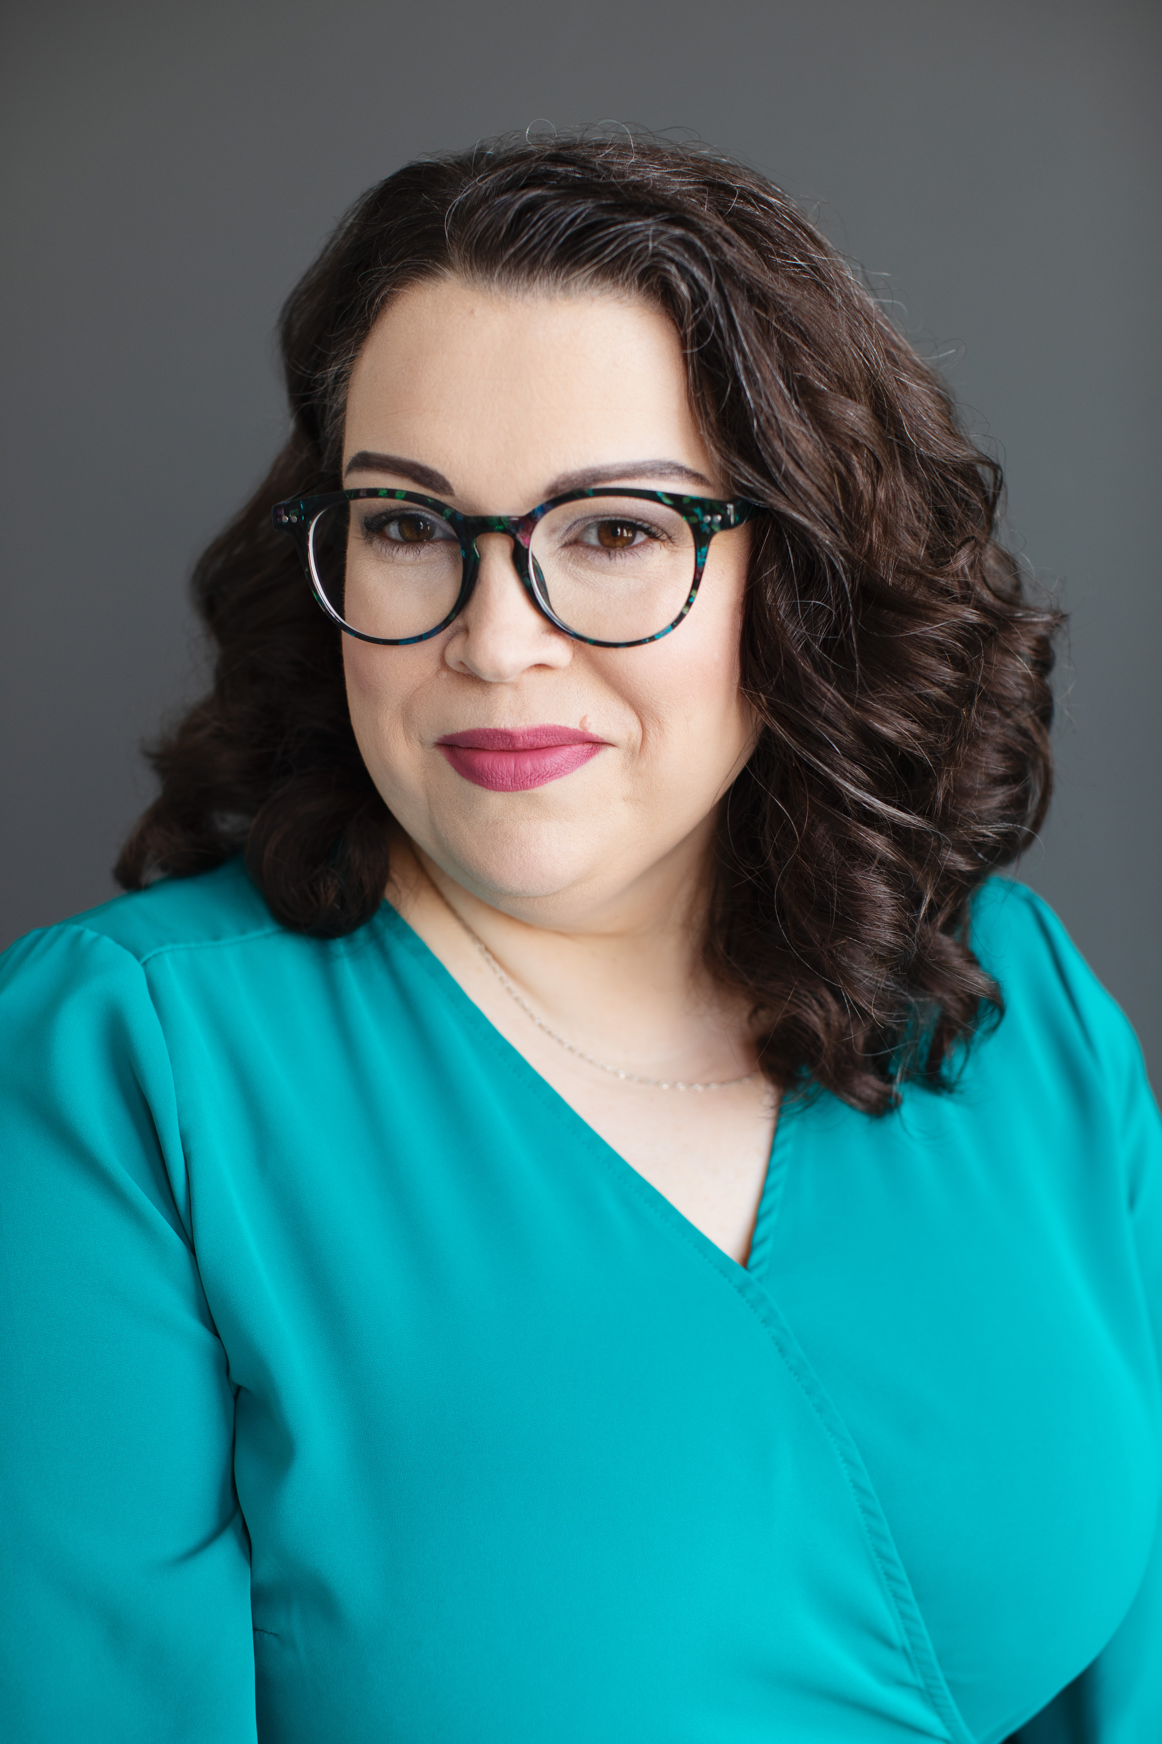
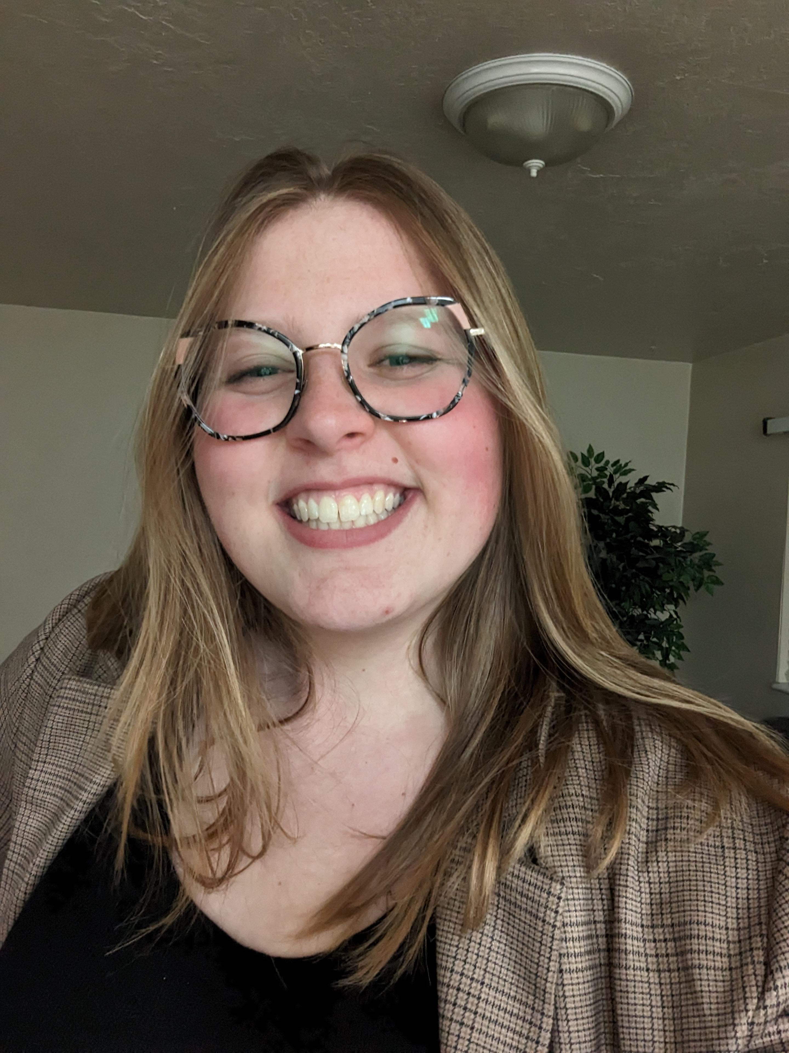
Thank you
Ellen Amatangelo ellen_amatangelo@byu.edu
Elizabeth Parret
elizabeth_parret@student.byu.edu

