Slide 1
WHAT ARE THEY SAYING? HOW TO USE INTERVIEWS FOR RESEARCH AND ASSESSMENT IN LIBRARIES
August 26, 2020
Dan Broadbent
Physical and Mathematical Sciences Librarian
Brigham Young University
dan_broadbent@byu.edu

Slide 2
Surveys, surveys everywhere...
Using the Poll window, please click yes or no to respond to these questions…
During the last month, have you been asked to take some type of survey or give some type of feedback? (whether or not you did it)
How about during the last week?
Hosted by ALCTS, Association for Library Collections and Technical Services

Slide 3
Surveys, surveys everywhere...
Remembering the last survey you took, did you –
give it enough time to do a thorough job?
feel like you were able to convey how you really felt about the topic?
give bogus answers just to mess with them.
Hosted by ALCTS, Association for Library Collections and Technical Services

Slide 4
Questions
Feel free to enter your questions during the presentation.
We will answer them at the end.
Hosted by ALCTS, Association for Library Collections and Technical Services

Slide 5
Introduction
Assessment in libraries is an essential part of managing library resources to meet the needs of patrons and stakeholders.
How to do it?
Interviews can provide more deep and rich information than simple surveys.
But... they are also more complicated and time consuming.
Photo by Mat Brown from Pexels https://www.pexels.com/photo/accuracy-alarm-clock-analogue-business-552598/
Hosted by ALCTS, Association for Library Collections and Technical Services

Slide 6
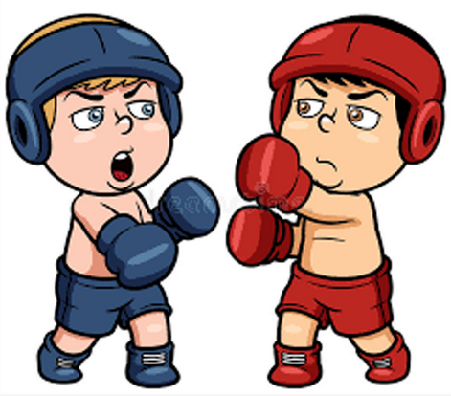
Surveys vs. Interviews
The battle between these two assessment tools is captured well by Irvine (2018):
“In the red corner, weighing in at a hefty time commitment and a massive transcription job, we have . . . INTERVIEWS! In the blue corner, weighing in at a stack of paper and variable data quality, we have . . . SURVEYS!”
Drawing from https://www.pngitem.com/middle/iJoTTRR_sales-cloud-vs-service-cloud-cartoon-hd-png/
Hosted by ALCTS, Association for Library Collections and Technical Services

Slide 7
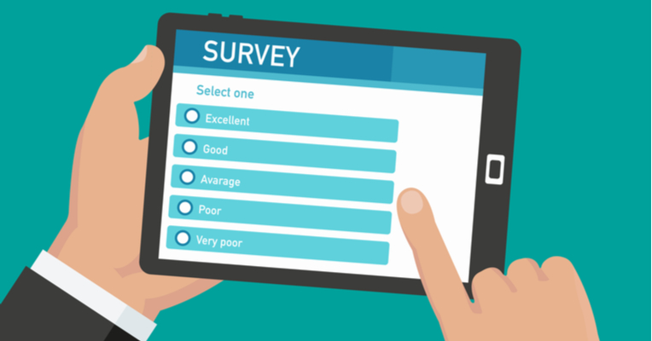
How to decide: Surveys vs. Interviews
Surveys:
Good for standardized, relatively simple questions.
Allow for large number of respondents.
Relatively easy to create summary reports.
Drawing from https://getthematic.com/insights/customer-survey-design/
Hosted by ALCTS, Association for Library Collections and Technical Services

Slide 8
How to decide: Surveys vs. Interviews
Interviews:
More personal.
Good for dealing with subtle human issues.
Allow for follow-up or probing questions.
Generally easier for the respondent, but harder on the researcher. (Valenzuela & Shrivastava, 2002, p. 3)
Good for questions that are better answered with descriptions than numbers.
Helpful to explore trends or experiences and come up with common themes. (Beck & Manuel, 2008)
Drawing from https://www.experis.com.sg/blog/2019/05/answers-to-7-common-interview-questions-what-would-you-do-in-your-first-90-days-in-this-position
Hosted by ALCTS, Association for Library Collections and Technical Services

Slide 9
Individual interviews
Note: this presentation emphasizes individual interviews – not focus groups.
(Some information will relate, though.)
For information specifically about focus group interviews, please see:
Walden, Graham R. 2006. “Focus Group Interviewing in the Library Literature: A selective annotated bibliography 1996‐2005.” Reference Services Review, Vol. 34 No. 2, 222-241. https://doi.org/10.1108/00907320610669461.
Hosted by ALCTS, Association for Library Collections and Technical Services

Slide 10
Interviews: in-person or phone/video?
To determine whether to do in-person or via phone/video, consider these factors:
Time and financial costs.
Geographical distribution of respondents.
Sensitive or controversial topics.
Technology problems.
Interviewer safety.
Note taking.
Interaction effects.
Nonverbal language and cues.
(Oltmann, 2016, table 1)
Drawing from https://trailhead.salesforce.com/fr/content/learn/modules/strategies-for-successful-software-engineer-interviews/own-your-onsite-interview?trail_id=navigate-the-salesforce-hiring-process
Drawing from https://blog.ripplecrm.com/telephone-interview-questions/
Hosted by ALCTS, Association for Library Collections and Technical Services

Slide 11
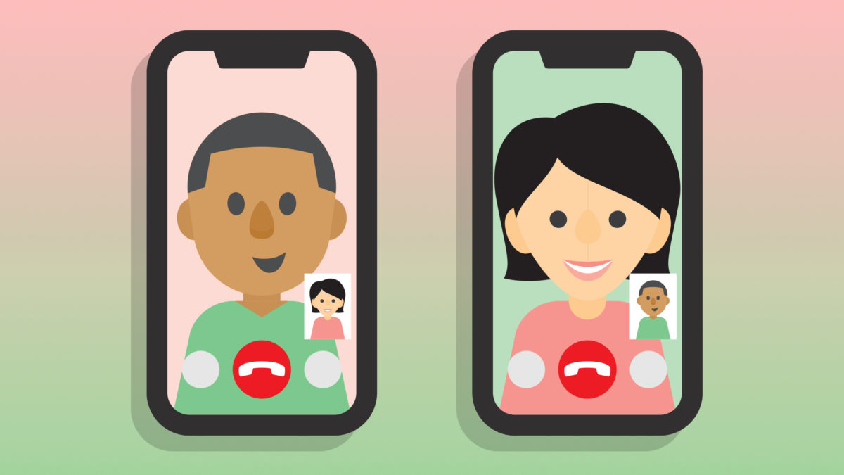
A thought on phone/video interviews
While phone/video interviews are convenient and can save time and travel expenses...
They will not allow as much of a personal connection to be made.
The recording quality will likely be lower.
(which will affect auto transcribing accuracy)
Drawing by David Lynch from https://www.payetteforward.com/what-is-video-calling-how-to-make-video-calls-on-iphone-android/
Hosted by ALCTS, Association for Library Collections and Technical Services

Slide 12
Types of Interviews
Structured
Ask the same questions to each participant.
Can be limiting.
Semi-structured
Set of guiding questions.
Allows for more flexibility.
Unstructured
Interviewer has idea they want to pursue.
Proceeds like a conversation.
(Wilson, 2012, p. 96)
Hosted by ALCTS, Association for Library Collections and Technical Services

Slide 13
Choosing interview candidates
Choose someone who is as directly involved with what you are researching as possible.
Conduct interviews in a timely manner, as soon as possible to the related event you are researching.
Hosted by ALCTS, Association for Library Collections and Technical Services

Slide 14
Choosing interview candidates
Avoid selection bias; choose a variety of people with diverse perspectives. However…
while you may want to have different ages, genders, races, etc. represented in your sample, if your study is to determine the needs of teenagers using your library, it won’t make sense to include elderly patrons.
Random sampling vs. deliberate selection.
In general, be careful to select people from among the demographics of the group you want to study without inadvertently choosing people you happen to prefer for some personal reason. (Collier 1995)
Hosted by ALCTS, Association for Library Collections and Technical Services

Slide 15
How many interviews?
Depends on the nature of the research you are conducting and when you reach “saturation” (the point at which no new themes are identified by conducting further interviews).
Generally speaking, 15 – 20 is a reasonable range to work with. (Baker and Edwards, 2012)
Resist the temptation to be an over-achiever…
The whole process will take a lot of time and too many interviews will just compound this.
I recently did 39 interviews – yeah, too many.
Hosted by ALCTS, Association for Library Collections and Technical Services

Slide 16
The interviewer
They will set the tone for the whole experience.
Library patrons are used to typical library workers being professional, helpful, and friendly.
The interviewer should be the same.
They can inadvertently cause bias.
They should practice asking questions and responding to comments in ways that don’t inject their own opinions.
Think pleasant and neutral.
(Valenzuela and Shrivastava, 2002)
Hosted by ALCTS, Association for Library Collections and Technical Services

Slide 17
Preparing the interviewer
Prepare them with ways to handle different types of people they may interview:
“dominant talkers, long-winded participants, the ‘expert’ type, argumentative types, and the shy person.”
Have ready:
“techniques and tactics to move the interview along, quell a potential argument, or draw out a reticent participant” (Wilson, 2012, p. 97)
Hosted by ALCTS, Association for Library Collections and Technical Services

Slide 18
To IRB or not to IRB?
IRB stands for Institutional Review Board.
They are charged with protecting people who are subjects of research.
Most universities have one.
If you are not sure if your organization has one,
check with the municipality, school district, or business that your library is part of to see how they would handle research that might need IRB approval.
Hosted by ALCTS, Association for Library Collections and Technical Services

Slide 19
Is IRB approval needed?
Yes, if...
you plan to publish or present the results, or
you are researching sensitive topics, or
you are using minors (under 18).
Otherwise, no
if you will just use the results for internal purposes.
However… this is not intended to be an official guide to determine the need for IRB approval. Be sure to contact your organization’s IRB to check.
(Imagine that being read too rapidly to really understand, in a low, slightly suspicious sounding voice.)
Hosted by ALCTS, Association for Library Collections and Technical Services

Slide 20
How to apply for IRB approval
Follow the details for your institution.
It will likely require:
A lengthy application. Ours was 13 pages.
You’ll need to define who the PI is (Primary Investigator).
Our IRB recently switched to an online system called “iRIS”
Biographical sketches of each researcher on the team describing their training and qualifications.
List of questions you will ask.
Consent form for interviewees to sign.
Copy of materials you will use to recruit/invite people to participate.
Hosted by ALCTS, Association for Library Collections and Technical Services

Slide 21
Quick Poll
Think of a time you were being interviewed (maybe for a job). What did you feel was the right amount for the interview to take?
Up to 15 minutes
16-30 minutes
30-60 minutes
Over an hour
Hosted by ALCTS, Association for Library Collections and Technical Services

Slide 22
Quick Poll
Now, in the context of a library assessment interview, how much time do you think the interviewee will feel is the right amount?
Up to 15 minutes
16-30 minutes
30-60 minutes
Over an hour
Hosted by ALCTS, Association for Library Collections and Technical Services

Slide 23
Creating Useful Questions
The goal of an interview is to get deep, rich, information from people in a way that only a conversation can do.
“Honing interview skills helps us nurture people through the storytelling process.”
(Jacob & Furgerson, 2012, p. 1)
Plan on having the interviewee do most of the talking.
Hosted by ALCTS, Association for Library Collections and Technical Services

Slide 24
Creating Useful Questions
Begin with easier questions and work toward more difficult. (Helps get people warmed up.)
Imagine you are the person being interviewed. What would you want to say? Create questions that give that opportunity.
Keep questions open ended. They allow more room interviewee to respond in their own way and based on their own experiences.
You have reasons for doing this research. What do you need to know in order to accomplish those purposes?
Must be within the bounds of anything you sent to the IRB.
Keep it fairly brief. You don’t want to wear out your interviewee. And, you’ll have to do the transcribing and coding later...
Hosted by ALCTS, Association for Library Collections and Technical Services

Slide 25
Conducting the Interviews
Interview protocols are helpful to not forget anything.
They are “not only a set of questions, but also a procedural guide for directing a new qualitative researcher through the interview process.” (Jacob & Furgerson, 2012, p. 2).
They should include:
What to say before and after the interview, including describing the purpose of the research.
A reminder to collect the signed informed consent doc.
A reminder to give a printed copy of the questions to the interviewee.
How to setup audio equipment, and confirm it is working!
What to do with files, to backup and protect privacy.
Hosted by ALCTS, Association for Library Collections and Technical Services

Slide 26
How to do the recordings
Hardware
A decent external mic will give better results than the built-in mics on most devices.
A good USB mic connected to a laptop is ideal.
We used a “Blue Snowball” mic.
Very good quality. $50 on Amazon or at Best Buy.
Software
Audacity is an excellent choice for Windows, Linux, and iOS devices but does not run on Android. (and it’s free)
Easy Voice Recorder, from Digipom, is a good choice for Android.
Windows voice recorder is a bit too limited.
Hosted by ALCTS, Association for Library Collections and Technical Services

Slide 27
How to do the recordings
Audio-output format
WAV vs. MP3
WAV will give the highest possible quality but will also have a larger file size.
MP3 is a compressed format. It will have a smaller file size but will also have lower audio quality.
In general, export to WAV for the best sound quality.
Environment
Keep as quiet as possible to make transcribing easier, especially if you will use automatic transcribing.
Avoid echoey places like hallways or big empty rooms.
Hosted by ALCTS, Association for Library Collections and Technical Services

Slide 28
How to transcribe the recordings
Human transcription services
Accuracy: claims range from 96 to 99 percent.
Prices: from $1.25 to $4.50 per recorded minute.
Turnaround times: 1-2 days or a few weeks, depending on how much you are willing to pay.
May be especially helpful if your interviews will include a lot of technical jargon or will have speakers with heavy accents.
Automated transcription services
Accuracy: claims range from 80 to 90 percent.
Prices: from $0.25 to $1.00 per recorded minute.
Turnaround times: usually a few minutes.
Hosted by ALCTS, Association for Library Collections and Technical Services

Slide 29
How to transcribe the recordings
Free options
Someone in your group, or you, listens and types as fast as they can.
Good times!
YouTube
Can upload audio file and it will generate transcripts.
Not private. Won’t satisfy IRB requirements.
Hosted by ALCTS, Association for Library Collections and Technical Services

Slide 30
Adventures in Transcribing…
Actual interview quote:
“In fact we’ll get to that - so now or later is just fine.”
Auto-transcribed quote:
“I'm thankful to God - so now or later is just fine.”
Picture from https://www.bennettig.com/news/greatful-people-are-thankful/
Hosted by ALCTS, Association for Library Collections and Technical Services

Slide 31
De-identifying transcripts to protect privacy
Depending on the sensitivity of the information, any IRB requirements, and who will review the transcripts, you may need to create deidentified versions of each transcript before allowing others to review them.
We replaced
Interviewee name
Interviewee work or subject area
Names of others referenced during the interview
Location of interview
with code numbers.
That meant we had to maintain a decoder spreadsheet for later reference if needed.
Hosted by ALCTS, Association for Library Collections and Technical Services

Slide 32
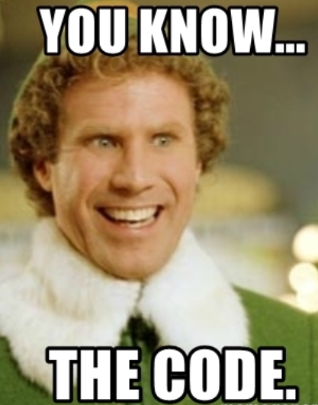
Identifying themes and creating codes
If you can, use a group to review the de-identified transcripts.
Will offer more perspectives.
Ask them to identify several themes.
Then, find a way to aggregate the themes.
We used sticky notes on a big whiteboard
How many codes?
Recommend 8-15.
Plus a “miscellaneous” catch-all, to use as a placeholder for later consideration.
We ended up with 11.
Picture from Elf
Hosted by ALCTS, Association for Library Collections and Technical Services

Slide 33
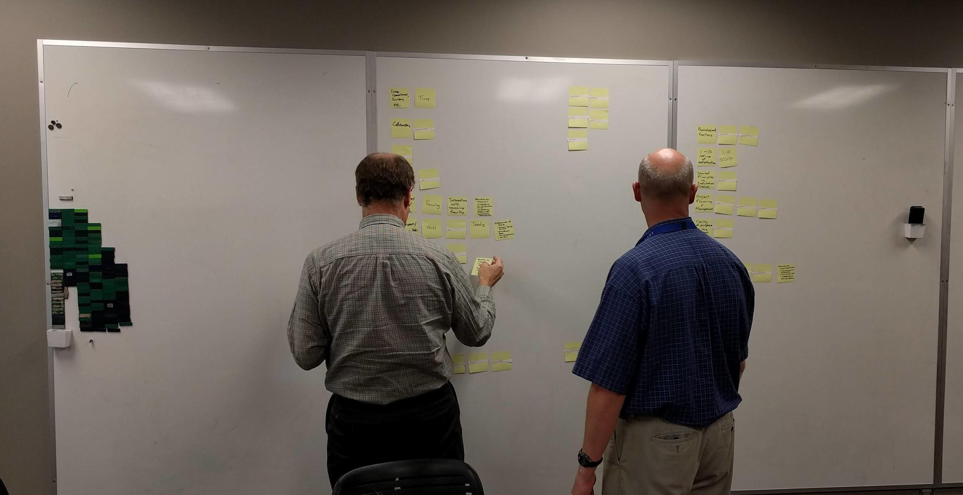
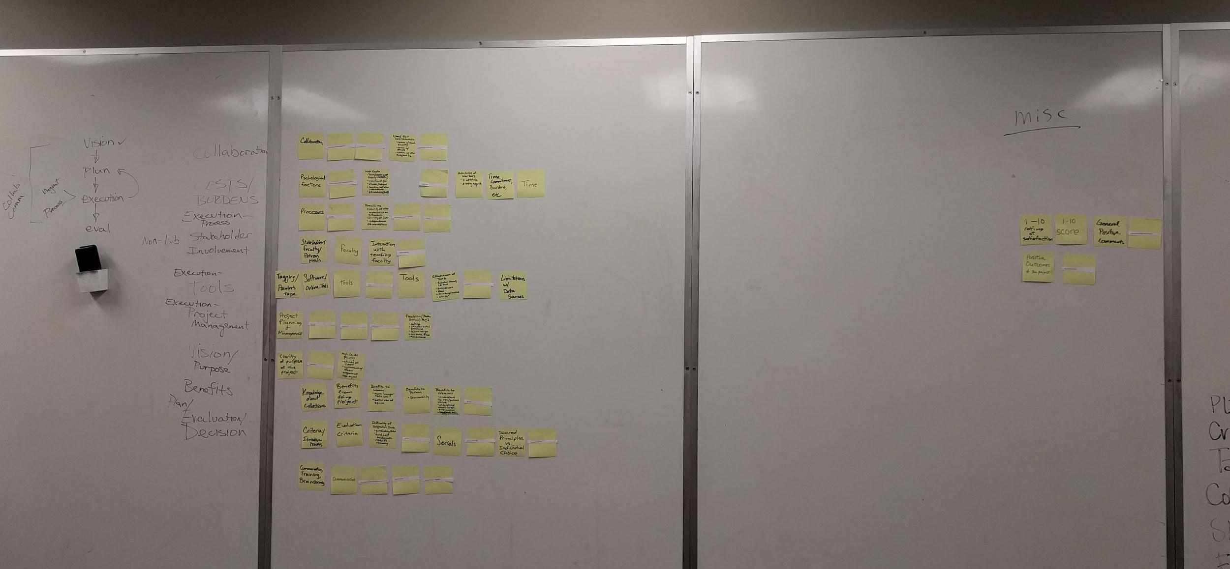
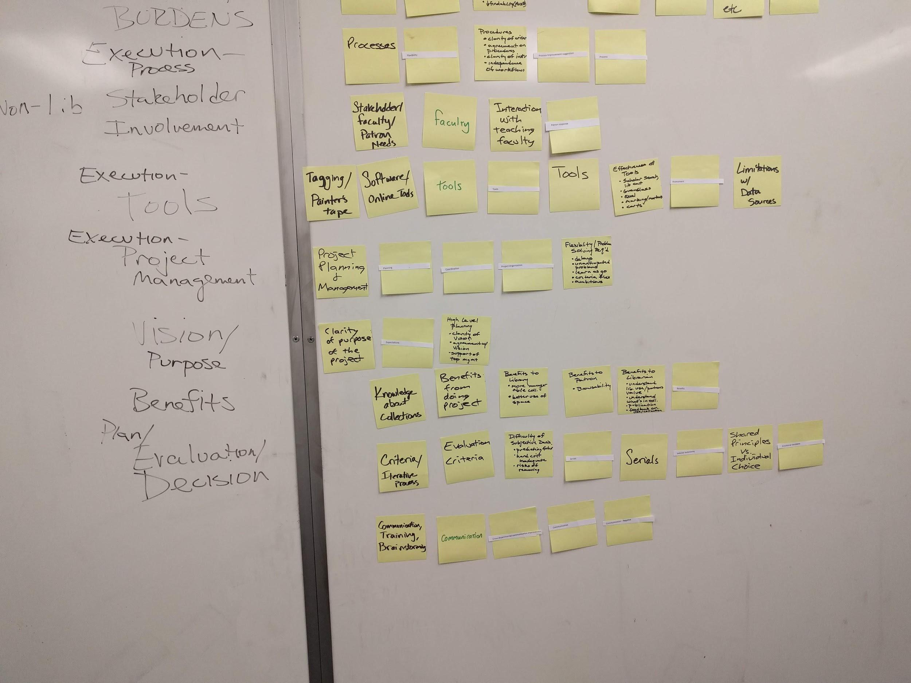
Our sticky note process
A group of 5 people reviewed the de-identified transcripts and came up with their own list of key issues or themes.
We wrote the themes on sticky notes and put them on big whiteboards.
Then we grouped the notes and wrote headings next to them.
Hosted by ALCTS, Association for Library Collections and Technical Services

Slide 34
Applying the codes
Very time consuming...
Ideally, have two people review each transcript and apply specific statements to the codes.
If they disagree on a part, have a third person be the tie breaker
For simple projects, a spreadsheet will likely do
Columns for the codes
Rows for interviewees, with specific quotes in the cells.
We used Quirkos. https://www.quirkos.com
Other good options:
NVivo
https://www.qsrinternational.com/nvivo/home
Dedoose
https://www.dedoose.com/
Hosted by ALCTS, Association for Library Collections and Technical Services

Slide 35
Reaching conclusions you can act on
The journey you have been on since completing the interviews can be summarized as…
going from talk to themes to codes to structure.
Talk
Themes
Codes
Structure
Read transcripts, and write themes on sticky notes.
Group sticky notes, and create categories and codes.
Assign relevant parts of transcripts to codes and structure.
Hosted by ALCTS, Association for Library Collections and Technical Services

Slide 36
Reaching conclusions you can act on
Now, you are ready for the last two steps:
going from structure to meaning, then to application.
Structure
Meaning
Application
Analyze coding structure for patterns and trends.
Articulate what the research has revealed and what actions to take.
Hosted by ALCTS, Association for Library Collections and Technical Services

Slide 37
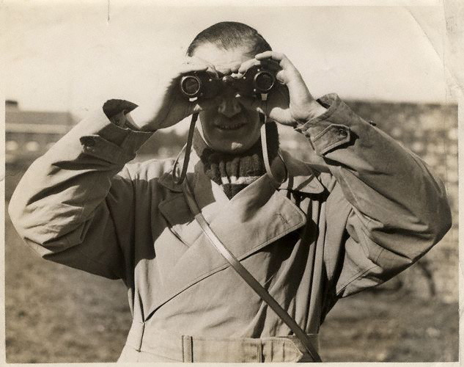
Reaching conclusions you can act on
To go from structure to meaning and application, look for the big picture. Search for:
broad concepts
common or recurring issues
unique, noteworthy nuggets
trends
unexpected views
actionable, worthwhile requests
Keep an open mind and avoid just looking for things that confirm your original thinking.
Also, it’s a good idea to do this with a group, to allow for multiple perspectives and to reduce individual bias.
Credit: National Portrait Gallery London
Hosted by ALCTS, Association for Library Collections and Technical Services

Slide 38
Reaching conclusions you can act on
Based on what you see, identify specific areas the research has shown to be important…
and then articulate specific actions that could address those areas.
You may run into some outlier opinions or ideas.
They may represent lone voices of reason in the wilderness… or just someone who didn’t get enough sleep the night before.
You (and your group) will have to be the judge on if certain ideas are worth considering or if they should be disregarded.
But, hey, that’s why they pay you the big bucks, right?
Hosted by ALCTS, Association for Library Collections and Technical Services

Slide 39
The Clothing / Coding Analogy
Adapted from Malterud (2012)
Clothing
Coding
Wash clothes. | Transcription and de-identification process.
Sort clothes. Group by color, owner, type (socks, sweaters, shirts), etc. | Do a casual read of transcripts, looking for overall concepts and patterns. “From talk to themes”
Build chest of drawers. Adjust size and number of drawers. Put labels on drawers. Have lots of stickers because you will be changing them often as you figure things out. | Meet with others on the research team to create grouping labels (codes) for the themes you noted in your casual read. “From themes to codes”
Put clothes into drawers. Look at each item and decide what drawer is the best fit for it. | Go through each transcript in detail and assign key ideas to codes. “From codes to structure”
Create a fashion show. Take a look at what you have to work with and begin combining the pieces into new and useful things. | Analyze coding results and see big picture direction it goes in. “From structure to meaning”
Market the new fashions. Name and describe the new fashions’ characteristics and features. | Articulate what the research has revealed and actions that will be taken. “From meaning to application”
Hosted by ALCTS, Association for Library Collections and Technical Services

Slide 40
Summary / Conclusion
Interviews can be better than surveys when dealing with subtle or complex issues, or where more thorough investigation is needed.
If you plan to publish the results of your interview- based research, or you are dealing with sensitive topics, or will use minors, you will need to get IRB approval.
Obtaining good results from an interview process involves
creating good questions,
training the interviewer,
recording the interview,
transcribing the interview,
de-identifying the transcripts and protecting privacy,
creating codes, and
interpreting the coded material.
Hosted by ALCTS, Association for Library Collections and Technical Services

Slide 41
Summary / Conclusion
The interview process can yield meaningful insights and help you to really connect with people in your library.
Don’t be afraid to break from the pack of survey givers.
Try it!
Creator:sompong_tom Credit: Getty Images/iStockphoto
Hosted by ALCTS, Association for Library Collections and Technical Services

Slide 42
Questions
We will respond to any questions that have already been entered.
Please enter any additional questions now.
Hosted by ALCTS, Association for Library Collections and Technical Services

Slide 43
References
Baker, S. E. & Edwards, R. 2012. “How Many Qualitative Interviews Is Enough.” Review Paper No. 19 for the National Centre for Research Methods.
Beck, S. E., & Manuel, K. (2008). Practical research methods for librarians and information professionals (pp. 109-129). New York, NY: Neal-Schuman Publishers.
Collier, D. 1995. Translating Quantitative Methods for Qualitative Researchers: The Case of Selection Bias. Vol. 89. doi:10.2307/2082442.
Franceschini, M. (1716). Guardian angel [painting]. Retrieved from https://www.dulwichpicturegallery.org.uk/explore-the-collection/301-350/the-guardian-angel/
Irvine, A. “Interviews vs. Surveys.” (January 16, 2018). Retrieved from https://thesislink.aut.ac.nz/?p=6198.
Is IRB Approval Required? (November 5, 2019). Retrieved from https://orca.byu.edu/IRB/IRBApproval.php
Jacob, S. A., & Furgerson, S. P. (2012). Writing Interview Protocols and Conducting Interviews: Tips for Students New to the Field of Qualitative Research. The Qualitative Report, 17(42), 1-10. Retrieved from https://nsuworks.nova.edu/tqr/vol17/iss42/3
Malterud, K. (2012). Systematic text condensation: A strategy for qualitative analysis. Scand J Public Health, 40(8), 795-805. doi:10.1177/1403494812465030
Oltmann, S. M. (2016). Qualitative interviews: A methodological discussion of the interviewer and respondent contexts. Paper presented at the Forum: Qualitative Social Research, , 17(2) 1.
Valenzuela, D. & Shrivastava, P. 2002. “Interview as a Method for Qualitative Research.” Southern Cross University and the Southern Cross Institute of Action Research (SCIAR).
Wilson, V. (2012). Research methods: Interviews. Evidence Based Library and Information Practice, 7(2), 96-98.
Hosted by ALCTS, Association for Library Collections and Technical Services

